Slide 1



Data Storage Solutions (Design and Development of data storage solutions for analysis)
Daniela Osinaga 10622199
Aditya Anilkumar 10606360
Abuzar Khan 10613710

Slide 2
Contents
Introduction
Schema
ETL
Visualizations &
Reports
Graph Databases &
Conclusion

Slide 3

Introduction
Logical and physical application of dimensional modelling, which can be found in such a way to analyze data of our origin, referring to their components or dimensions, for the purpose metric or business measure.
Reasons for Choosing this subject area was among vivid options this dataset was very much close to the fulfillment perquisites of the assignment. In addition, this data can analyze some.
E.g. what was the highest sales week in 2019,
Which branch is the most profitable throughout
3

Slide 4
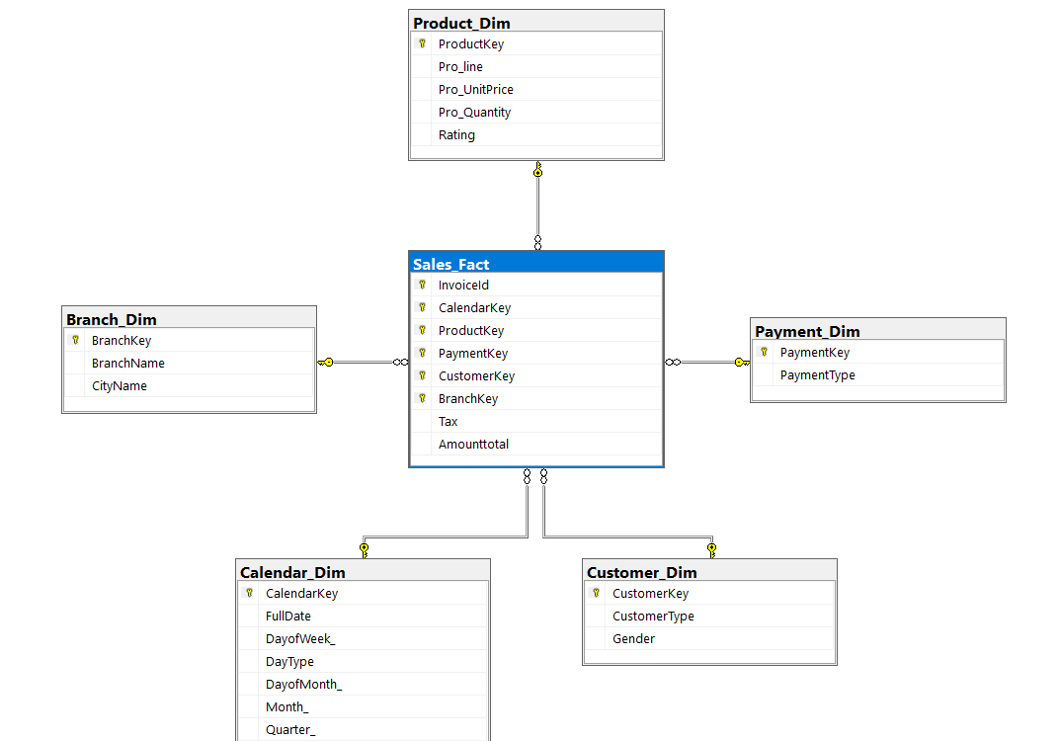
Schema
Dataset has been acquired from Kaggle was then discussed upon and carefully Schema was designed.
Being a small data most gullible atrocities were to include certain categories like gender and customer_type
To include invoice in the schema or not was a decision to be made but with consideration from the module leader it was finally opted out.
Our final design for schema then was star design, with a fact table dimension tables connected with customer, payment, calendar, branch, product dimensions.

Slide 5
ETL(Extract Transform Load)
Extraction of data from CSV files to cleaning the data and then transforming it into something meaningful then finally loading it into the SQL Management studio to conclude of the transformation process its uploaded into SQL management studio, medium used for the purpose is MS visual studio code (previous versions).
Acquiring data and making it through with the data in the simple and same format to upload into the data warehousing process,
Cleaning of the data and making it sure there are no null values within the dataset and all the data types are valid and there are no corrupt variables.
Transformation of the columns of customer, product, payment, branch etc into dimensions and connecting the dimensions altogether in a common fact table and thus viewing it as a complete star schema
Loading the dataset further on that is processed, into sort of production role.
5

Slide 6
Visualization and Reports
Dashboard creation on Tableau with drill down approach and feature specific approach to make it user friendly and most importantly SSRS reports where there we many types of reports were discussed in team.
Some insights for reports created are as follows:
Total Sales per Branch (Pie chart)
Product sold based on the payment method.
Sales of product per week.
Monthly sales and taxes.
SSRS (SQL Server Reporting Services).
SSRS based on Different aspects E.g. Per product, per Branch, sales monthly report or payment method.
6

Slide 7
Graph Databases
Neo4j being world’s leading graph database, the architecture is designed for optimal management, storage, and traversal of nodes and relationships. The graph database takes a property graph approach, which is beneficial for both traversal performance and operation runtime. Neo4j offers dedicated memory management and memory-efficient operations. Neo4j is scalable and can be set up as a single server or on a group of machines in a production environment that can handle failures. Other features for production applications include hot backups and extensive monitoring.
We created our graph database using the same technique and double checked our queries and it was the same as we viewed in the ETL process.
We made it liable to some relationships and matched the correct features.
7

Slide 8




Thank you
Daniela Osinaga
Aditya Anilkumar
Abuzar Khan

